Slide 1
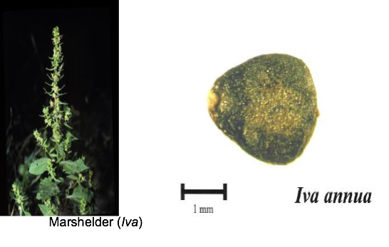
Plant of the day: Marshelder
Close relative of ragweed and sunflower
Domesticated in eastern North America as an oilseed
Domesticated form now extinct

Slide 2
Crop domestication

Slide 3
Big Questions:
Where, why and when were plants domesticated?
What are domestication traits?
What is the difference between domestication, diversification and improvement?
What kinds of genetic changes are under selection during domestication?
Do analyses of evolution under domestication inform us about evolution under natural selection?

Slide 4
Centres of domestication
Archaeological evidence suggests that hunter-gatherers independently began cultivating food plants in at least 12 regions of the world (Doebley et al. 2006)

Slide 5
Reasons for domestication
THINK - PAIR - SHARE
Why were plants domesticated?

Slide 6
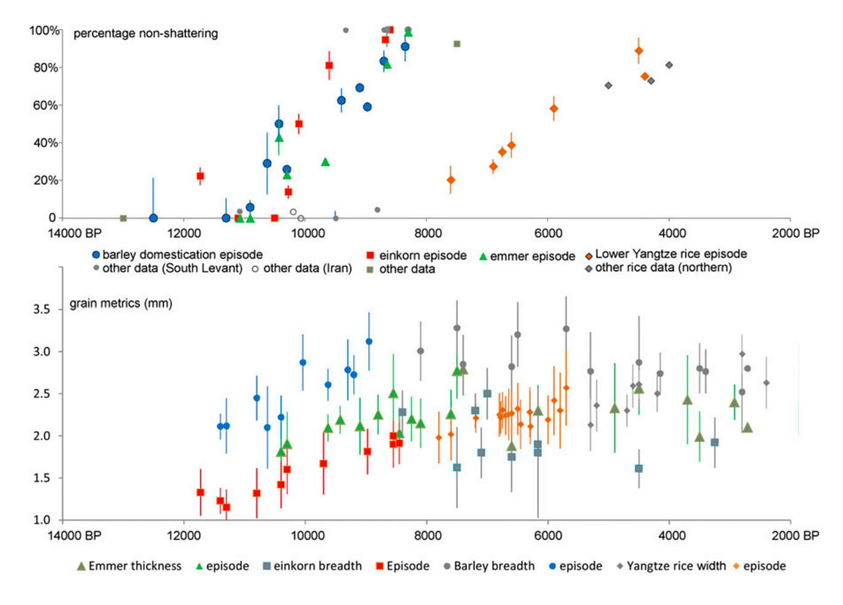
Speed of domestication

Slide 7
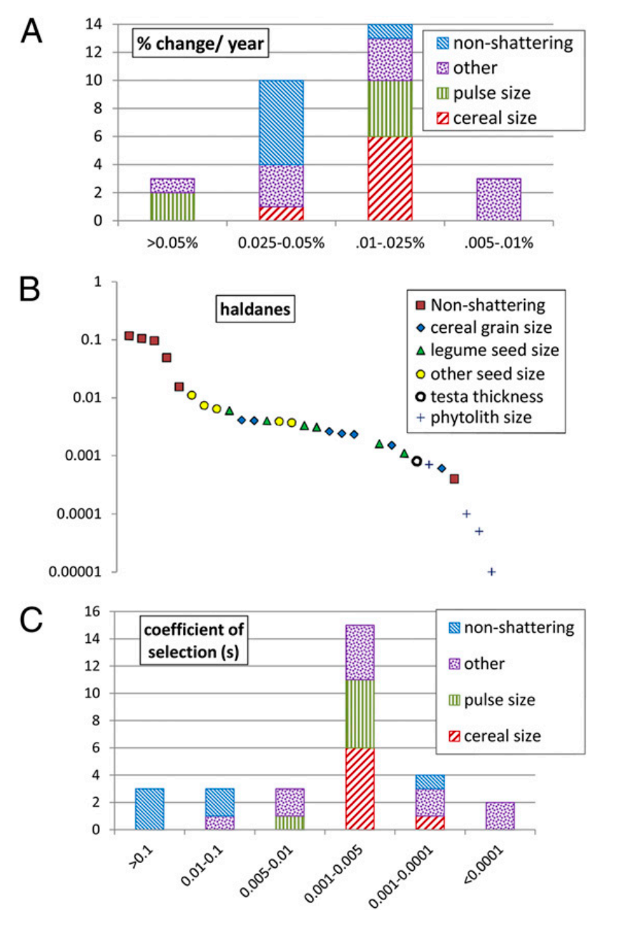
Speed of evolution

Slide 8
Domestication bottlenecks

Slide 9
Domestication Bottlenecks
Breeding between cultivars or with wild progenitors can restore diversity.
The level of bottleneck depends on the species and the level of domestication

Slide 10
Domestication Syndrome
A domestication syndrome describes the properties that distinguish a certain crop from it’s wild progenitor.
THINK - PAIR - SHARE
What are some domestication traits?
What about for seed crops vs. root crops vs. fruit crops?

Slide 11
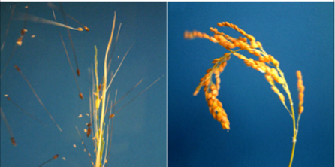
Domestication traits
A lack of shattering

Slide 12
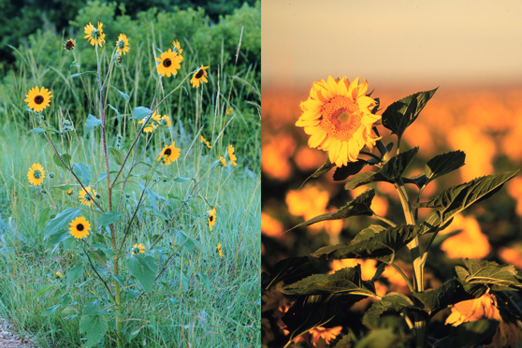
Domestication traits
Less branching

Slide 13
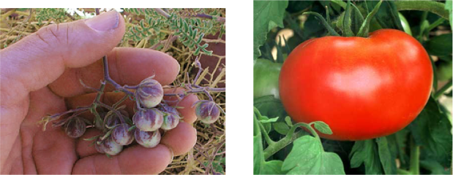
Domestication traits
Fewer larger fruits

Slide 14
Domestication as a process
The distinction ‘domesticated’ or ‘not domesticated’ is an over-simplification
Some crops have moved further along this process further than others.
We can recognize different levels of domestication
How can we decide which level?

Slide 15
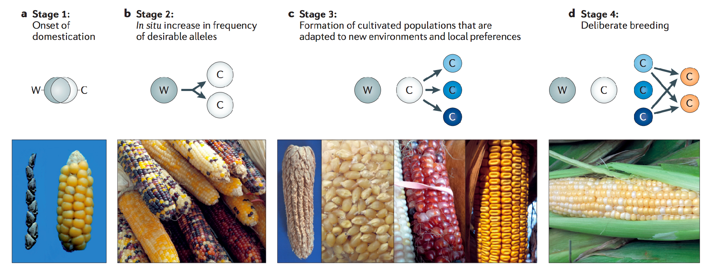
Domestication process
Domestication
Diversification
Improvement

Slide 16
Domestication process
Domestication
Diversification
Improvement
How might improvement traits be different from domestication traits?

Slide 17
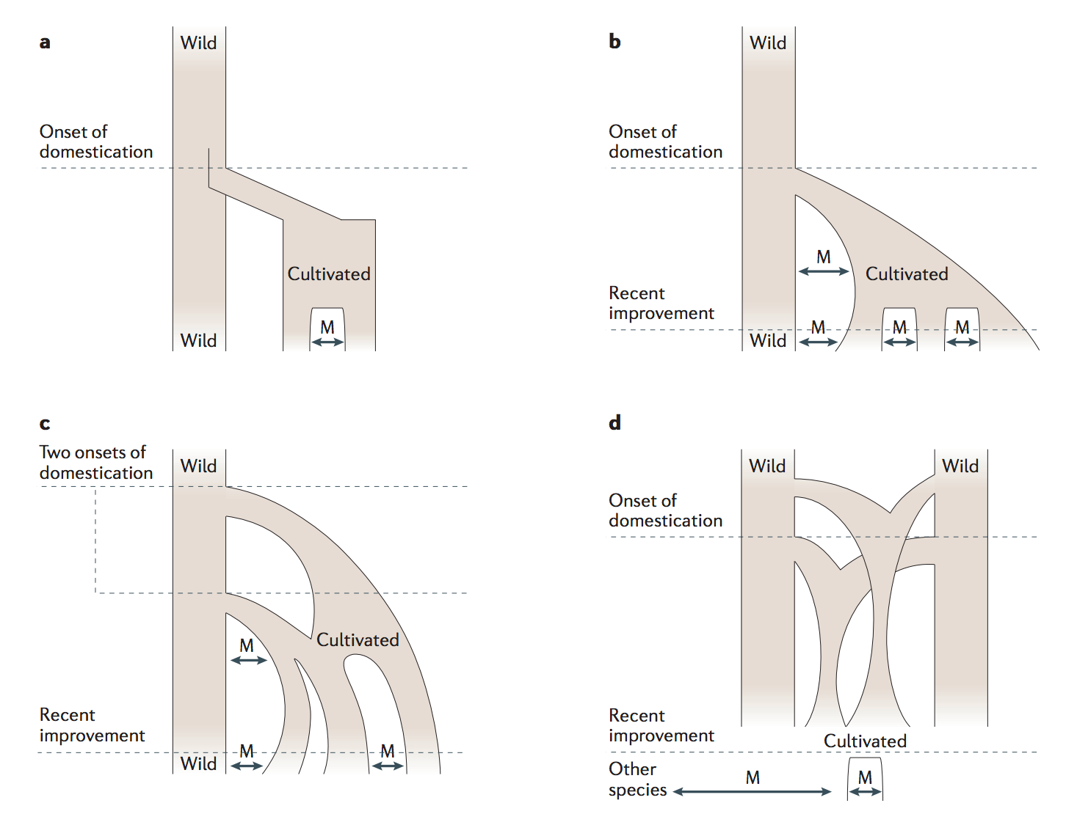
Domestication process
Older view

Slide 18
Domestication process
Plants can have multiple origins of domestication
Barley, bottlegourd, coconut, common bean
Gene flow between cultivate crops and wild progenitors during domestication is also possible

Slide 19
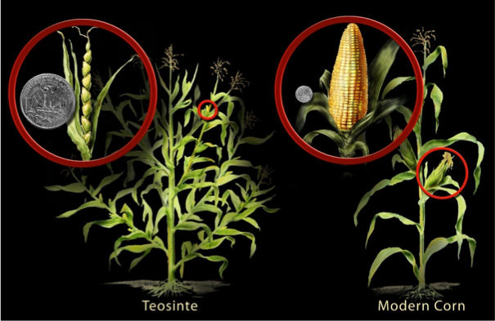
Maize domestication

Slide 20
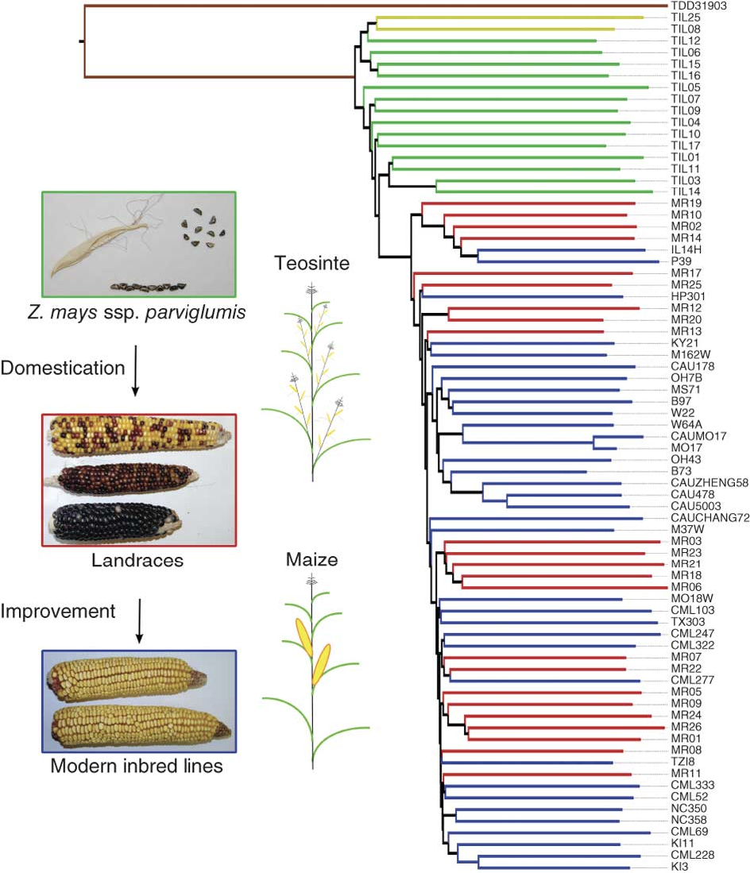
Maize domestication
Single origin
Hufford et al. 2012

Slide 21
Maize domestication
5310 year old maize cob!
Ramos-Madrigal et al. 2016

Slide 22
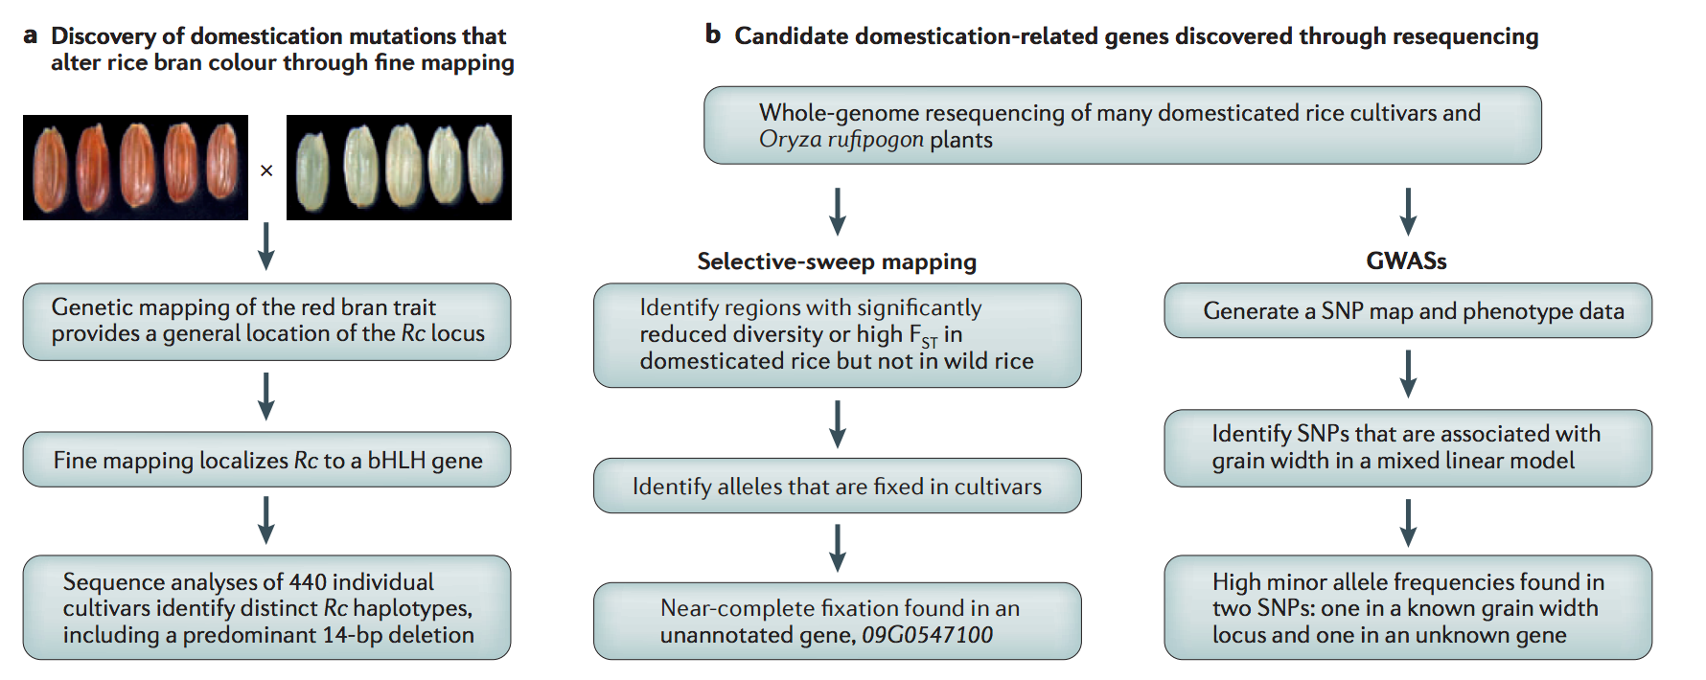
Detecting domestication genes
Meyer and Purugganan 2013

Slide 23
Detecting domestication genes
THINK - PAIR - SHARE
What are some weakness of each method?

Slide 24
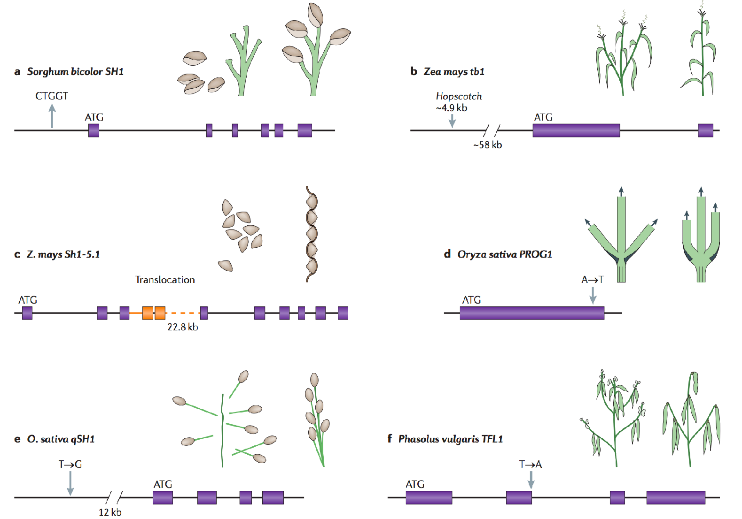
Domestication genes

Slide 25
Domestication genes
A majority of domestication genes are transcription factors
Are enriched for genes of large effect (loss of function alleles)
Can be new mutations or be found in the wild progenitor

Slide 26
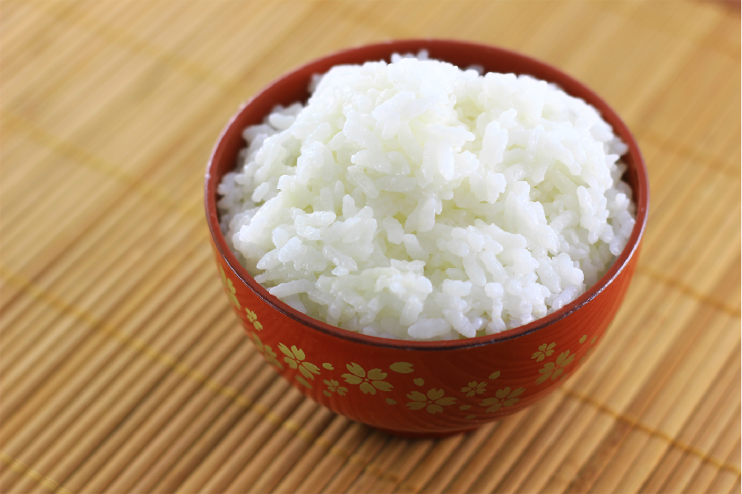
Genetic parallelism
Sticky rice is caused by a mutation in the WAXY gene
Mutations in the same gene cause sticky varieties in broomcorn millet, foxtail millet and three Amaranthus spp. pseudocereals

Slide 27
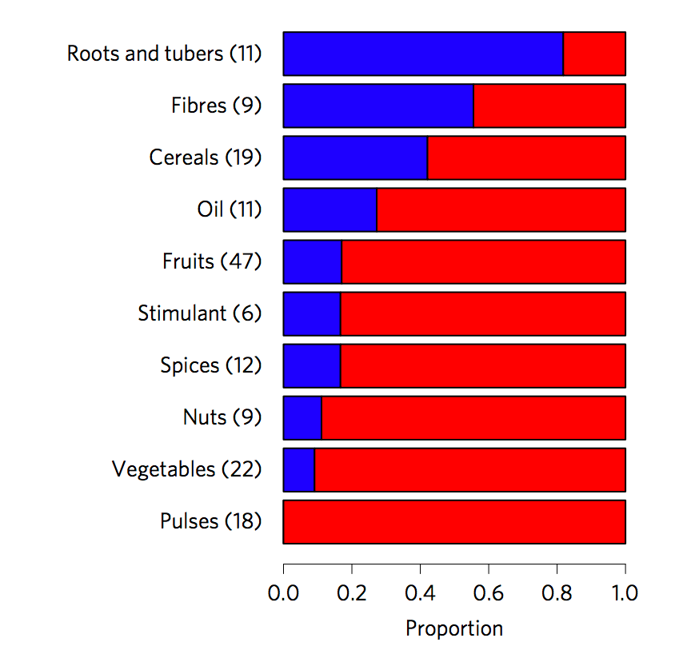
Polyploidy and domestication

Slide 28
Polyploidy and domestication

Slide 29
Polyploidy and domestication

Slide 30
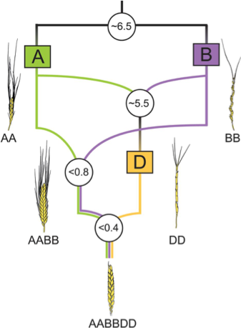
Polyploidy and domestication

Slide 31
Unanswered questions
Why are some crops only weakly domesticated?
Are the major effect domestication genes/mutations cloned so far representative of other crops/genes/mutations?
What is the role of reproductive isolation in domestication? What about gene flow from wild relatives?
Do domesticated plants carry high levels of genetic load?

